Slide 1
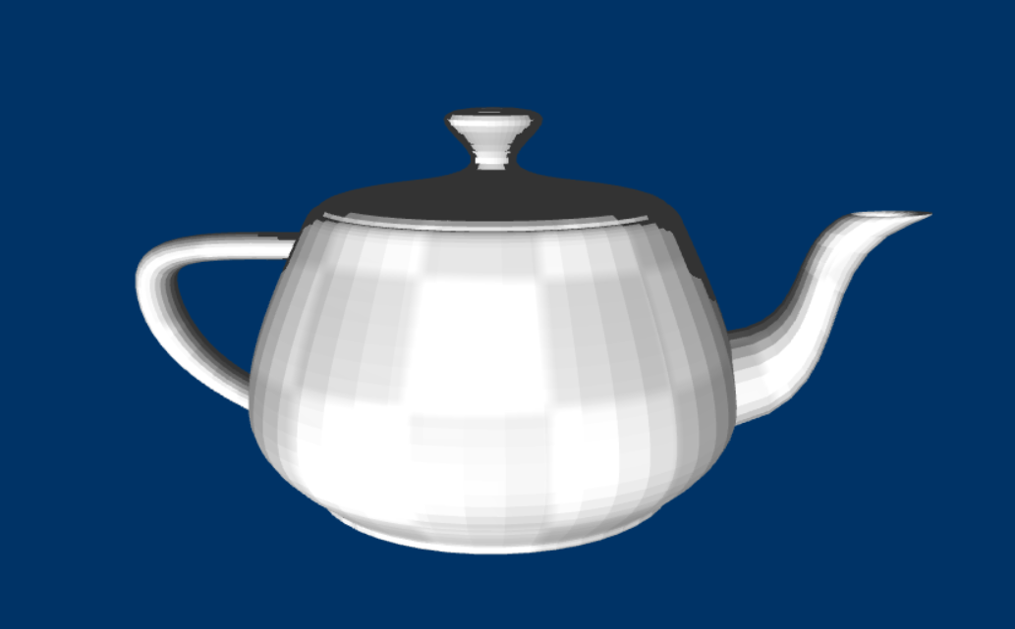
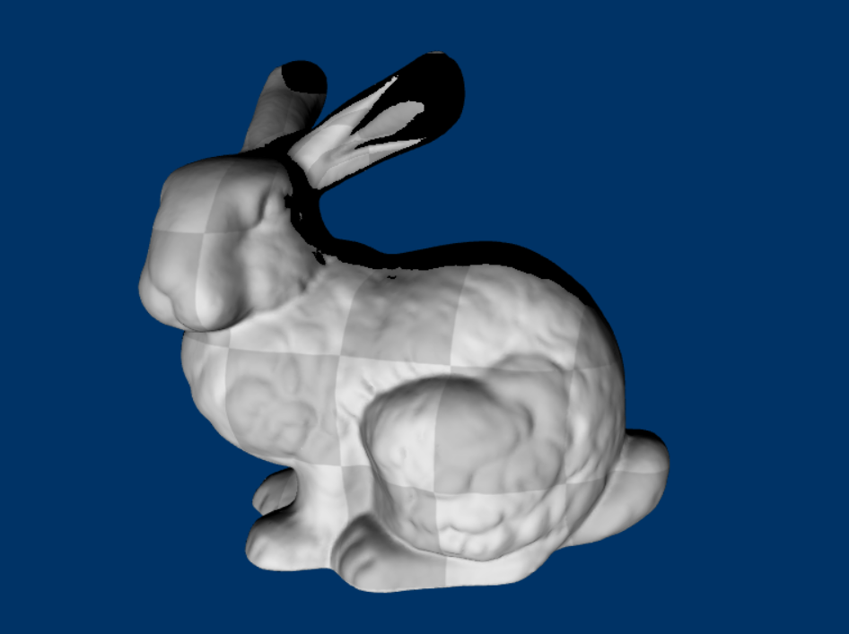
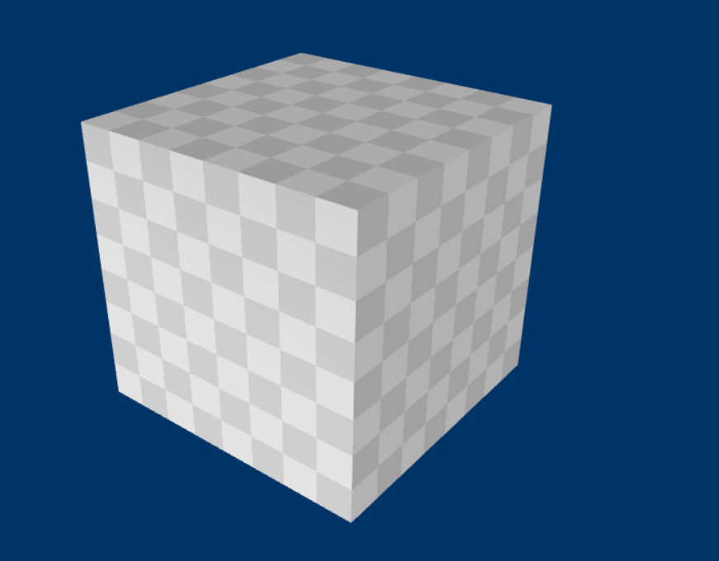
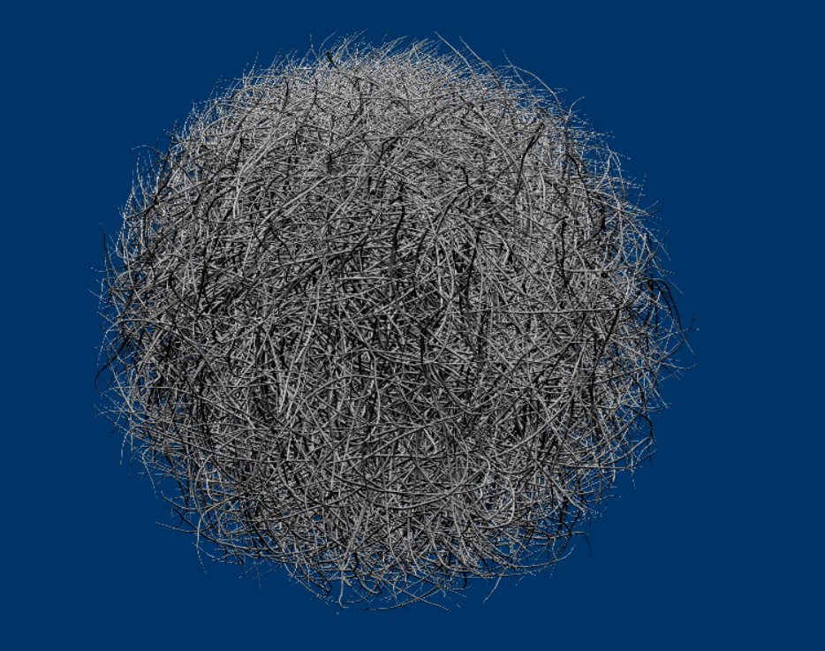

Slide 2
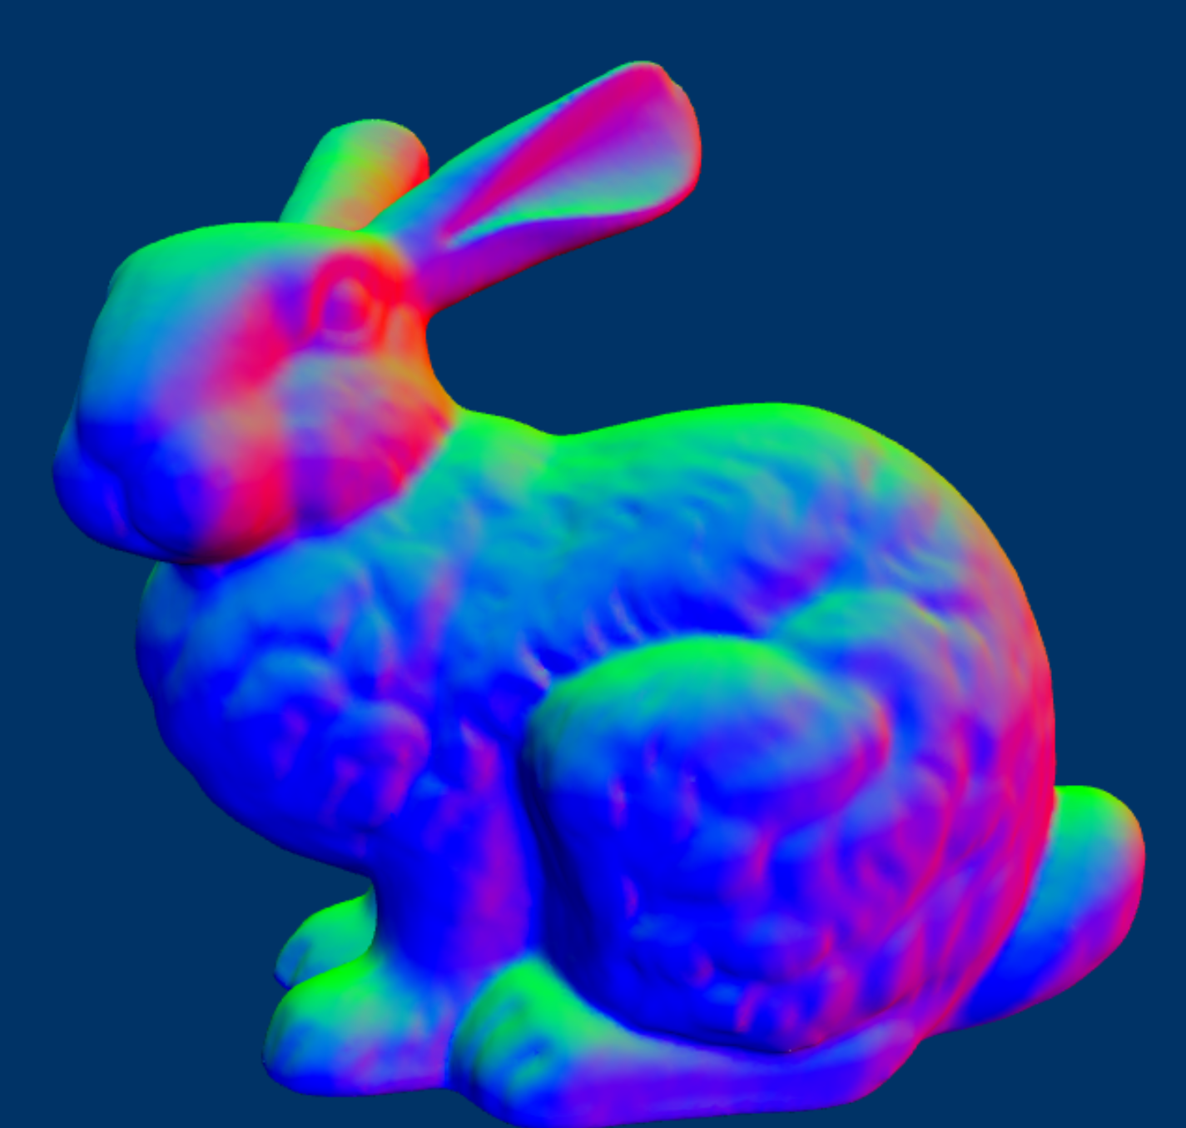


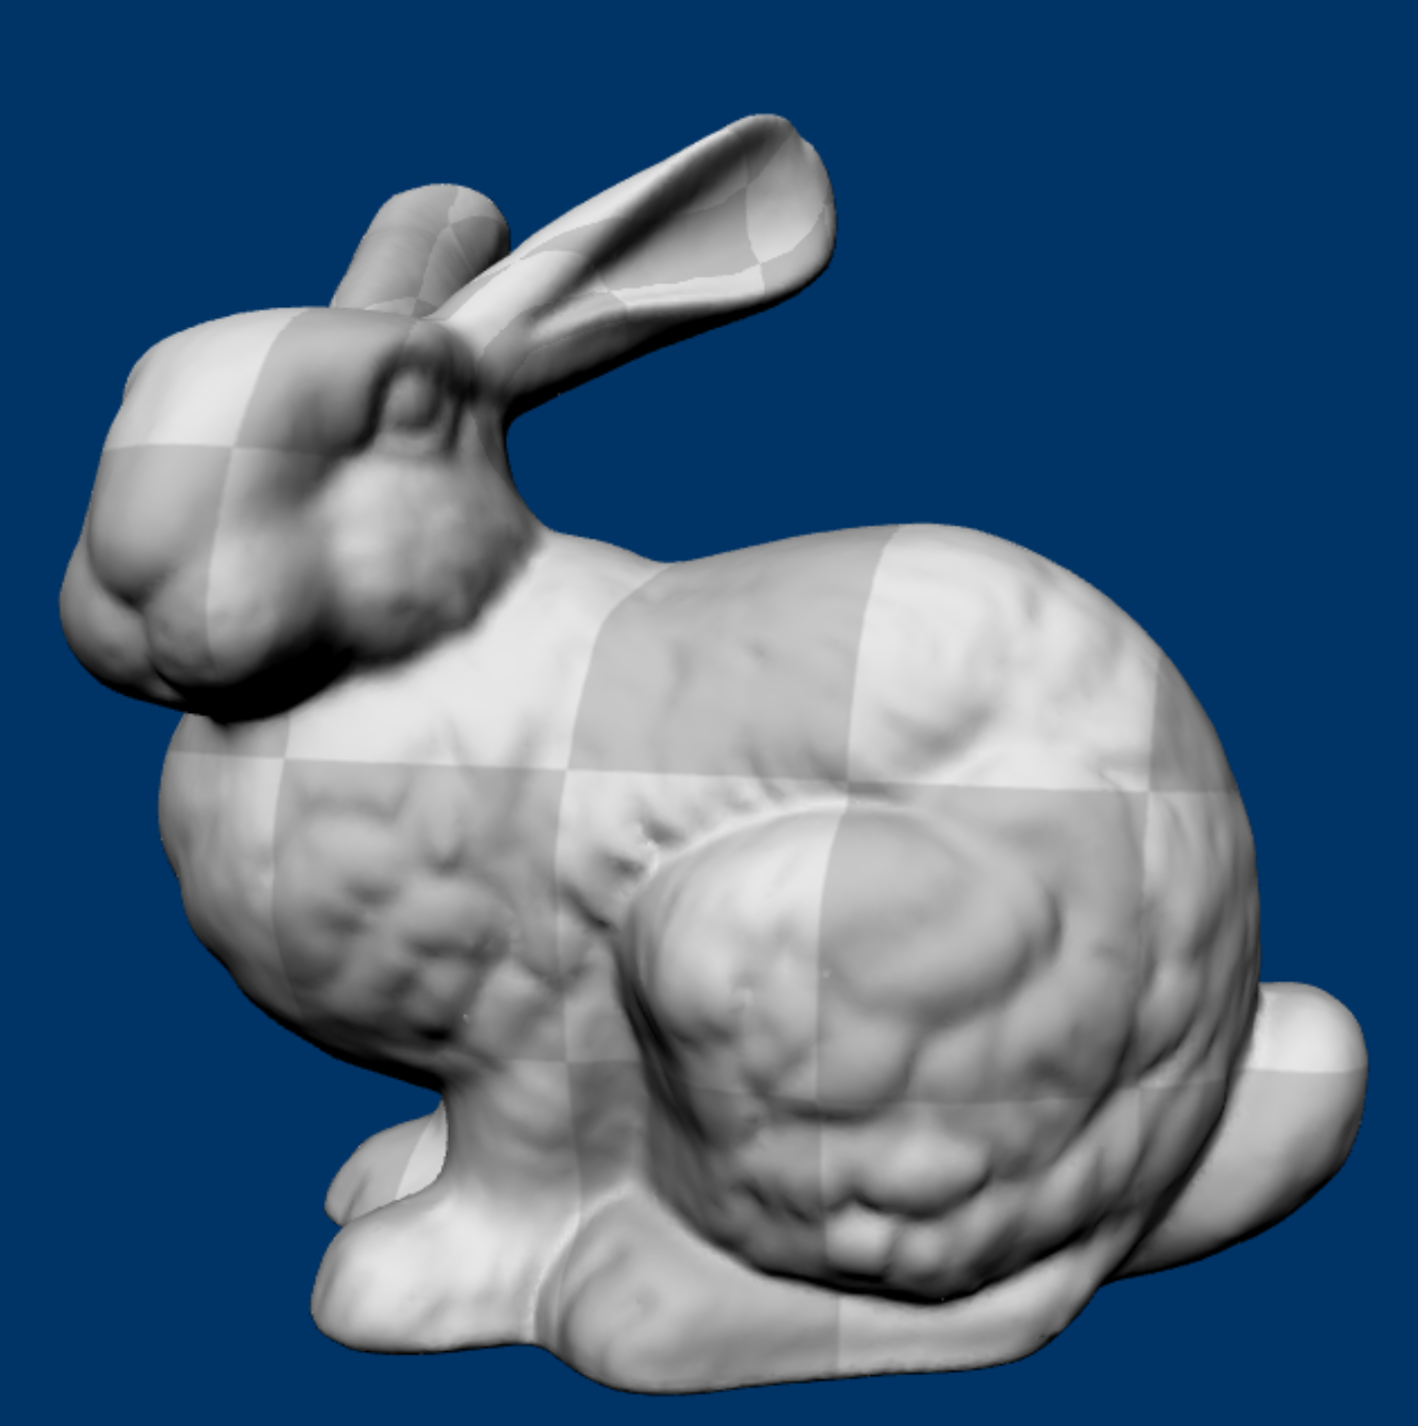
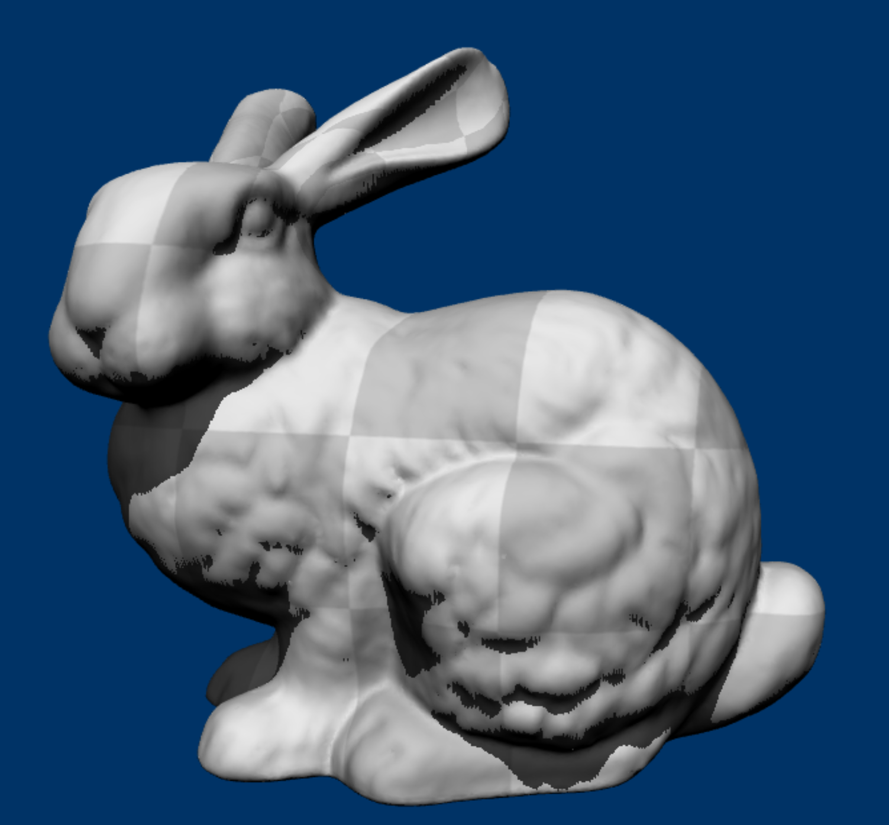

Slide 3
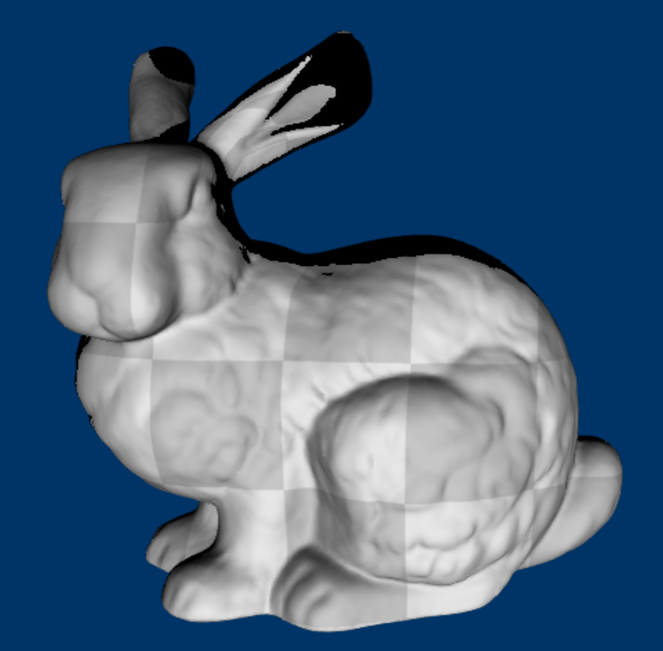
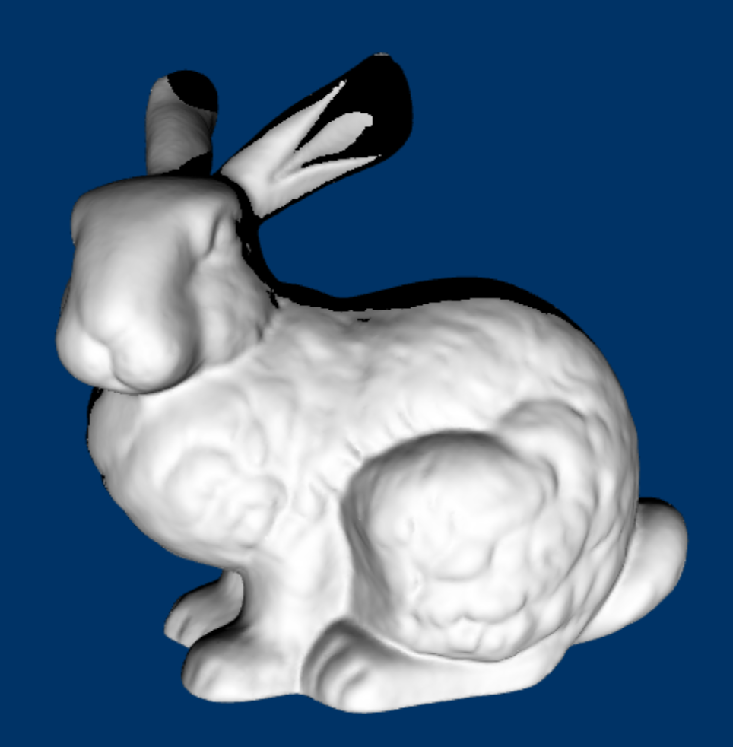

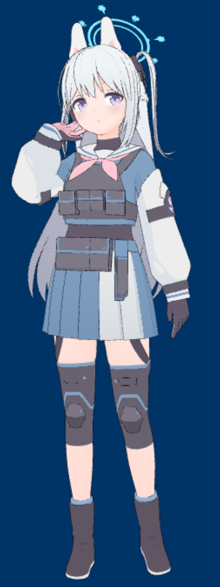
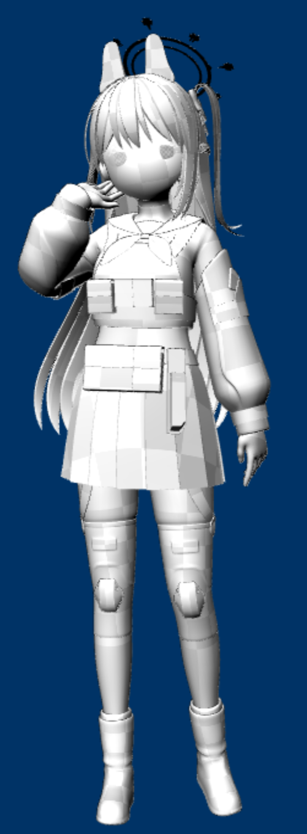
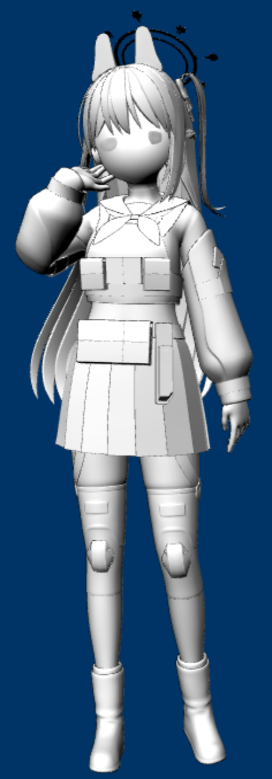

Slide 4
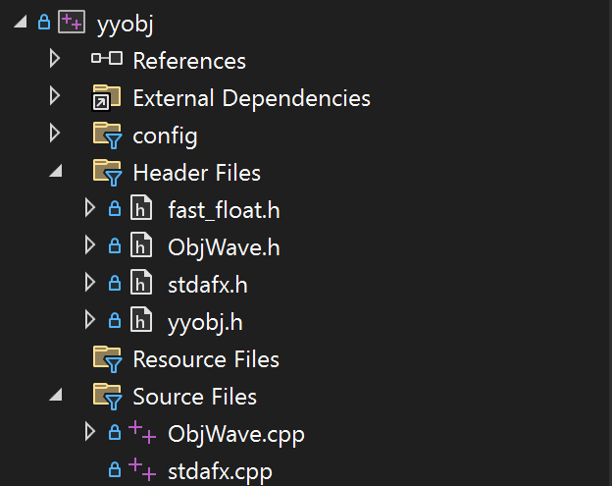
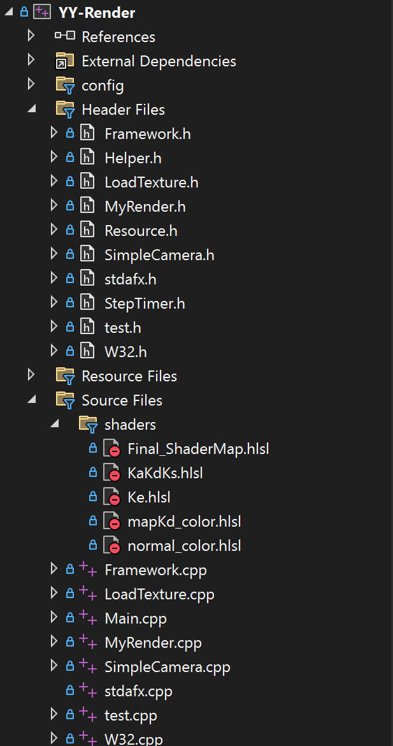
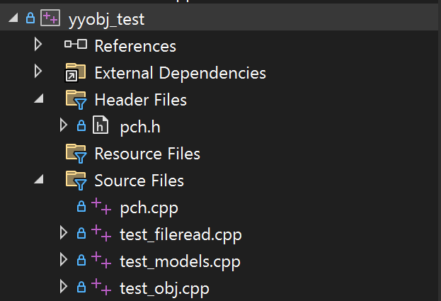

Slide 5
f
face-vs
V
Vt
Vn
1
0
0
3
2
0
0
3
0
0
4
5
0
3
f 1 2 3
f 4/5 5/1 6/3
f 7//9 10//11 1//2
f 1/2 3/4 5/6 7/8
………
5
1
0
6
3
0
7
0
9
3
10
0
11
1
0
2
1
2
0
4
3
4
0
5
6
0
7
8
0

Slide 6
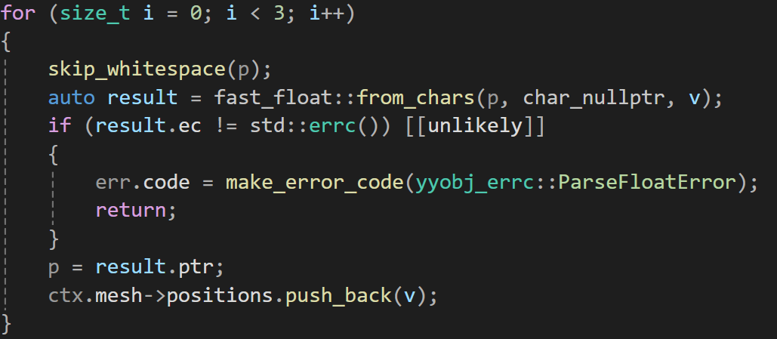
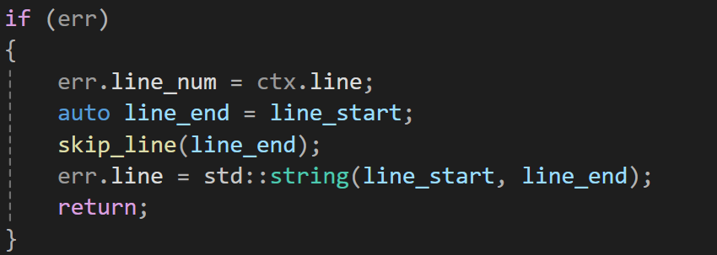
Return error code
Handle error code

Slide 7
1
0
0
2
012
012
023
1
2
023
3
3

Slide 8

y
Camera towards
x
z
yaw
pitch

Slide 9
0
1
2
3
4
5
6
7
8
9
10
11
12
c0
c1
s0
s1
s2
s3
s4
s5
s6
s7
s8
t0/t1
s9
Size
1
1
Size(textures)
Size(materials)
Type
CBV
SRV
SRV
CBV
Details
SceneConstantBuffer
ShadowMapTexture
Textures
Materials

